Slide 1
REAL Estate Regression Project
Chris Costa

Slide 2
Contents
Introduction and Goals
Cook County Grading Systems
Factors for $650k+
Location
Summary

Slide 3
INTRODUCTION & Goals
In this project we have taken a large set of data on homes sold in King County WA between 2014-2015. Using Machine Learning algorithms, SQL analysis, and Tableau visualizations we will attempt to analyze this data to make insights on the factors that determine home sale prices. Particularly of interest to us are the factors that determine the highest value homes on the market.
The data includes some 22,000 homes ranging from 1900-2015 and sale prices from $78,000-$7.7 Million. The variety of features in our data set should lead to practical intelligence for the modern realtor.

Slide 4
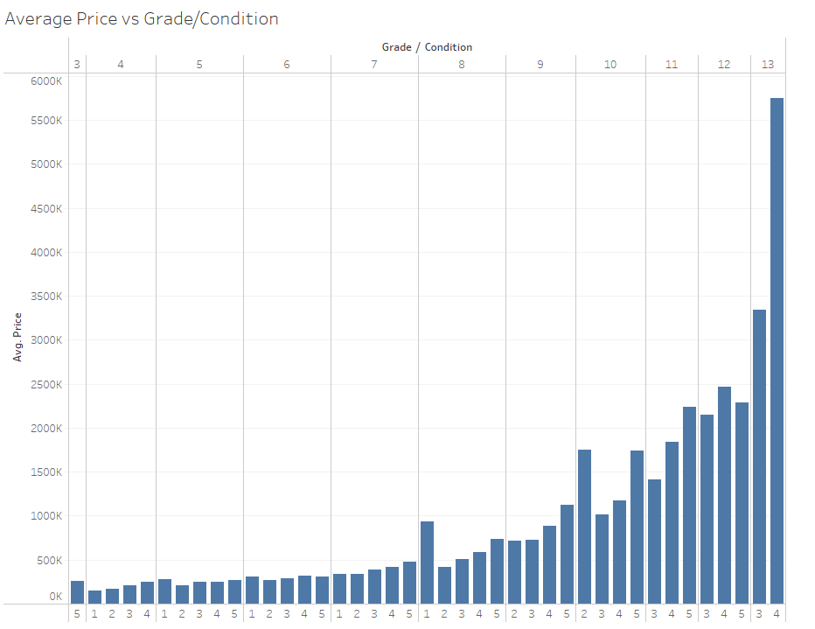
King County grading systems
The Cook County Grading Systems consist of a 1-5 Condition score and a 1-13 Grade, shown here against the average home sales price.
The steady rise in price across the grade spectrum is easily predictable. Perhaps less so is the higher price for the lowest Condition homes in Grades 8 and 10. These points suggest that a poor condition home in a desirable location or with other features can fetch a strong price thanks too (or perhaps in spite of) its fixer-upper status.

Slide 5
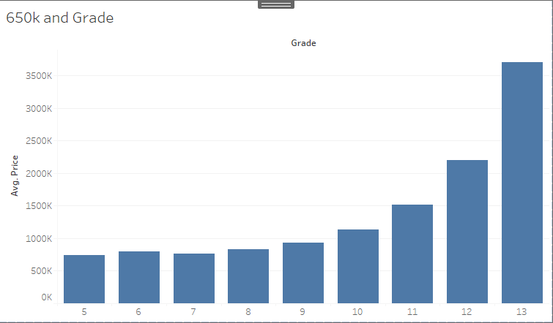
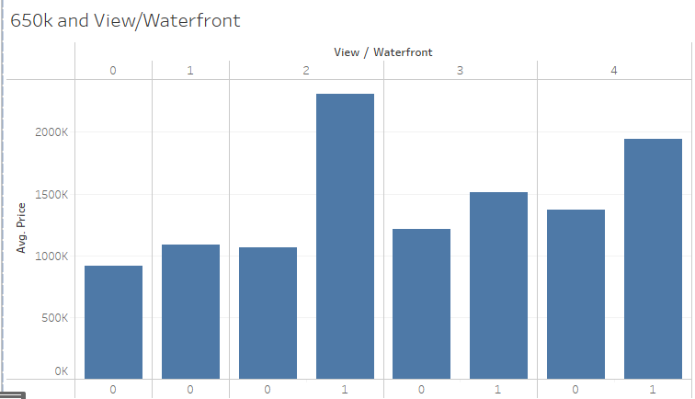
Factors for $650k+
Price vs Grade above $650k
Sticking with the grading systems temporarily we can see here distribution of Grades when filtered for the higher value homes in the area.
We can see from this table little effect on price for much of the Grade scale, very little change from 5-9 but a steep increase above that level with a large jump to the highest Grade homes.
Also of note is the lack of data below Grade 5 for homes in this price level.
Price vs View/Waterfront above $650k
Here we have a binary score representing waterfront property and a 1-5 (shown as 0-4) rating of the overall view from the home.
The view rating is not shown to have a clear effect on the sale price. The most expensive homes in our data were only in the median view score while being significantly more expensive the higher rated views.
Waterfront is a clear indicator of higher value across all levels of view; a median view waterfront property shown to be of the highest value here. Views 1 and 2 had no waterfront properties in this data subset.

Slide 6
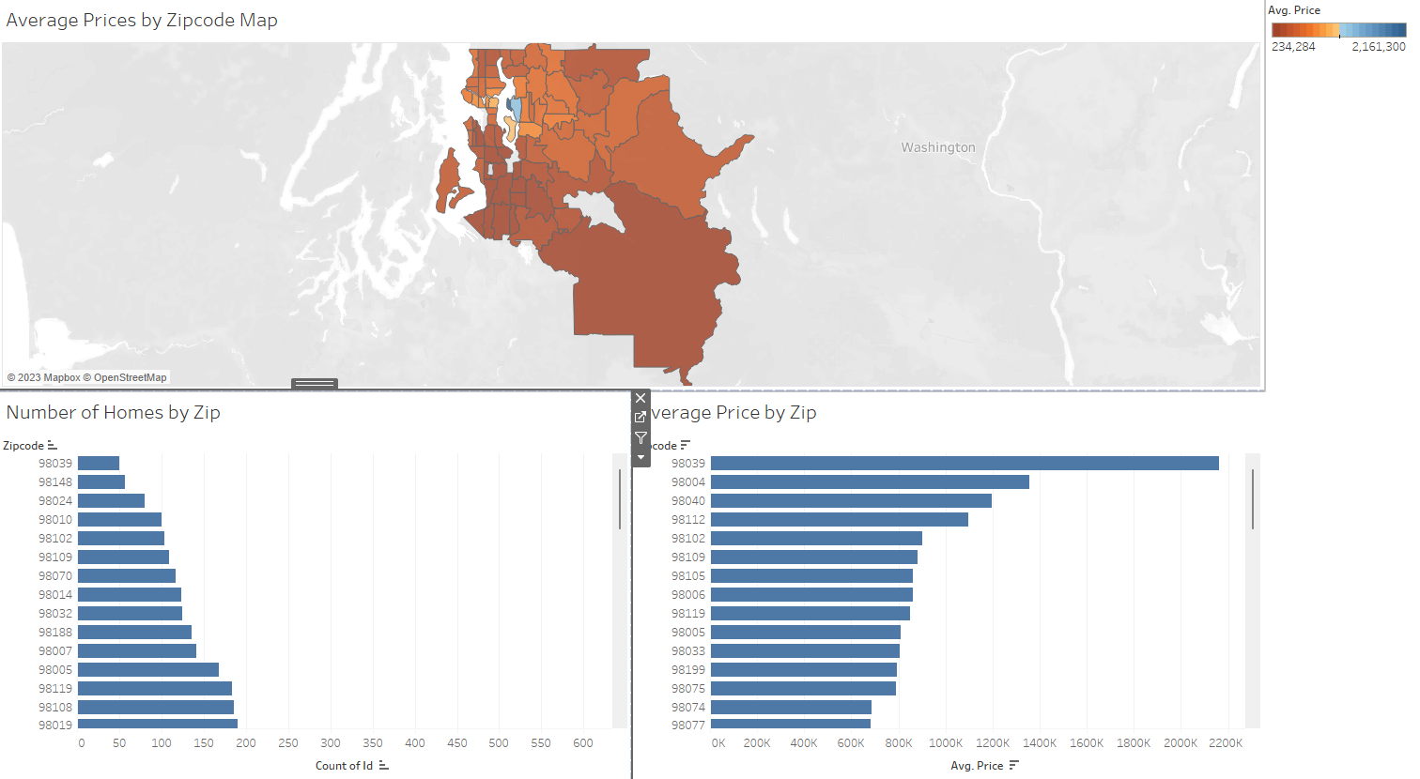
Average Price by Zipcode
In this slide we have a visualization of the average price in each zipcode covered in our data as well as the number of datapoints (homes) in each zip.
As seen in the color-coded map and the corresponding bar charts below the highest value zipcode is also the smallest zipcode in the area. The exclusivity of this area could be assumed to be a factor on sales price. SQL analysis indicates only a single waterfront property in the area and a spread of mid-to Condition and Grade scores would suggest that location is one of the biggest deciding factors in this case

Slide 7
SUMMARY
Our data has led us to some useful insights, even iof not entirely surprising.
When it comes to determining sales price the King County grading system appears to be a useful factor, if only effective at the upper end of the scale.
Waterfront property is a major selling point in King County as it throughout the country. The attempt of the data to rate the view of a particular home has proven ineffective on the other hand, at least for our purposes.
Ultimately, in the King County area at least, zipcode location appears to be one of the most important factors in predicting a home to be in the top of the value charts.

Slide 8
THANK YOU For Your Time
Chris Costa
chriscosta051@gmail.com
https://github.com/rhubarb-watermelon

